Slide 1
Subsidiary ICT for Uganda
Curriculum Topic 12 out of 15: ELECTRONIC PUBLICATION
Recommended Coverage Duration: 32 periods (5 ¹/₃ weeks)
Senior Six Term I
Notes:
Guidance to the Teacher
For each of the items to be developed in this topic, let the learners develop, make a presentation of their designed item for the rest of the class to comment and make improvements in the item. Where possible, get a third party to determine what they need in order to advertise a product.
Discourage the learners from using inbuilt templates while designing each of the items.
Train learners how to adjust the units of measurement from inches, to pixels and to centimetres for learners to develop this competence.
You are advised to organise the teaching in form of a project to allow the learner develop specific skills at a time.
As much as possible demonstrate to learners and allow them time to develop the skills of their own through the project work.
Suggested Competences for Assessment
Assess the learners’ ability to create and design an electronic publication in form of a flyer or banner to a level of advertising an item.

Slide 2
Background
Electronic publishing has a history of being used to describe the development of new forms of production, distribution, and user interaction in regard to computer-based production of text and other interactive media.
Electronic publishing enables professional designers to create sophisticated documents that contain text graphics and many colours. It is ideal for the production of high quality colour documents such as textbooks, corporate newsletters, marketing literature (adverts), product catalogues and annual reports, and being able to share them over the Internet.
Learning Outcome: The learner should be able to design a brochure, business card, flyer or banner for a given function.

Slide 3
Publication Outline
UACE Sub – ICT Topic 12:
Electronic Publication
Sub Topic 12.1: Introduction to Electronic Publishing
Sub Topic 12.2: Publishing Basics
Sub Topic 12.3: Document Enhancement
Sub Topic 12.4: Document Layout
Sub Topic 12.5: Advanced Features

Slide 4
Sub Topic 1: Introduction to Electronic Publishing
Sub topic Objectives:
Meaning of electronic publishing
Examples of electronic publishing software
Features of electronic publishing software
Application areas, uses for electronic publishing

Slide 5
12.1.1 Meaning of electronic publishing
In this chapter, ‘electronic publishing’ is used to mean ‘desktop publishing’ which refers to laying out text, graphics and pictures in order to produce a professional-looking print publication.
Desktop Publishing (DTP) Software applications provide special tools for fine-tuning the appearance of text and graphics in a document, much more than a word processor would do.

Slide 6
12.1.2 Examples of electronic publishing software
The following is a list of major desktop publishing software. A wide range of related software tools exist in this field, including many plug-ins and tools related to the applications listed below.
Microsoft Publisher
Adobe Page Maker
QuarkXPress
Adobe InDesign
Coreldraw
Studio Publisher
Scribus
Online Desktop Publishing Software
Canva
Fatpaint
Lucidpress – A desktop publishing and page layout software that is collaborative

Slide 7
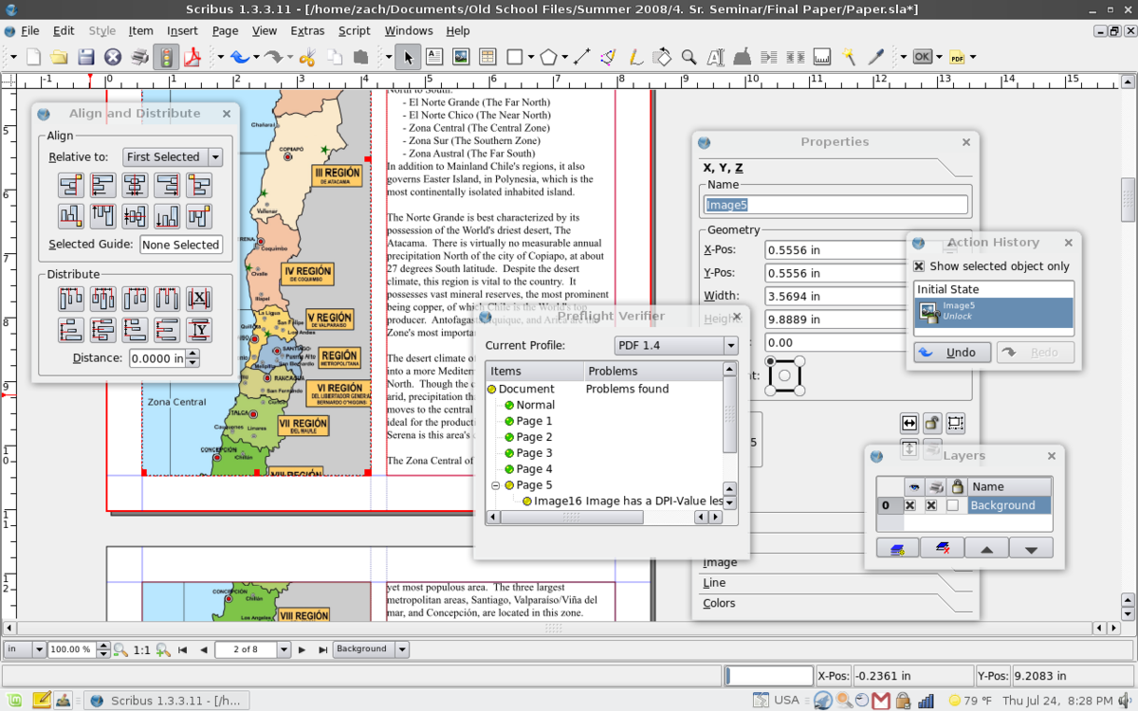
12.1.2 Examples of electronic publishing software
Scribus, an open source desktop publishing application.

Slide 8
12.1.3 Features of electronic publishing software
Comparing Word-processing and Desktop Publishing features
Desktop Publishing and Word Processing have many similar features, and it may not be obvious which of the two packages you should use to produce a document. The similarities are:
Both deal with text, which can be formatted (font, size, colour, bold, italic, etc.)
Both can contain pictures and tables
Microsoft Word and Publisher have similar features, such as, WordArt, colour schemes, text boxes, etc.

Slide 9
12.1.3 Features of electronic publishing software
Differences between word processing and desktop publishing
Word Processing | Desktop Publishing
Word Processing programs are designed to focus on text. | Designed to focus more on the structure or display of a document.
2. WPs are generally more condensed than DTPs and so are better suited for transferals across the internet. | 2. Large size and more complicated file formats, users usually convert them to portable document format (.pub) before transmission.
3. WPs only allow the simplest edits to graphic such as changing of its size inside a document. | 3. DTP programs give the user the tools required to greatly edit a piece of graphic

Slide 10
12.1.3 Features of electronic publishing software
Differences between word processing and desktop publishing
Word Processing | Desktop Publishing
4. Contain a few simple templates for letters, memos, resumes, and reports. | 4. Contain lots of advanced templates for brochures, business cards, certificates, calendars, newsletters, etc.
5. Many people have word processing skills because it is easier to learn, and so typists who only do word processing get lesser business jobs today. | 5. People who know desktop publishing typically get much larger business jobs than people who only do word processing.
6. All designing is user created and this wastes time. For example: Formatting a newsletter in a word processor may take several hours for every issue while formatting a newsletter in a professional publishing program will take several hours the first time and only a fraction of the time for subsequent issues. | 6. Desktop publishing uses software to aid designing and increase the amount of functions and increase the speed and transfer abilities in the document.

Slide 11
12.1.4 Application areas, uses for electronic publishing
Desktop publishing software can be used in a number of areas such as:
Advertisements,
Award Certificates,
Banners,
Brochures,
Business Cards,
Business Forms,
Calendars,
Catalogs
Envelopes,
Flyers,
Gift Certificates,
Birthday/ Wedding Cards,
Invitation Cards,
Labels, Postcards,
Letterheads,
Menus,
Newsletters,
Paper Folding Projects,, Resumes, Signs, Posters, etc.

Slide 12
Sub Topic 12.2: Publishing Basics
Sub topic Objectives:
12.2.1 Creating a new document
12.2.2 Adjusting measurement units (inches, pixels, points, and centimetres).
12.2.3 Saving a new document
12.2.4 Typesetting text.

Slide 13
12.2.1 Creating a new document
We are going to use Microsoft Publisher for all examples and practical aspects of this topic.
Before we learn how to create documents in publisher, lets first open and take a look around the Publisher window.
The Publisher window contains many parts that work together to make creating a document easy.
Opening Publisher on Windows
From the Start menu, select All Programs » Microsoft Office » Microsoft Office Publisher

Slide 14
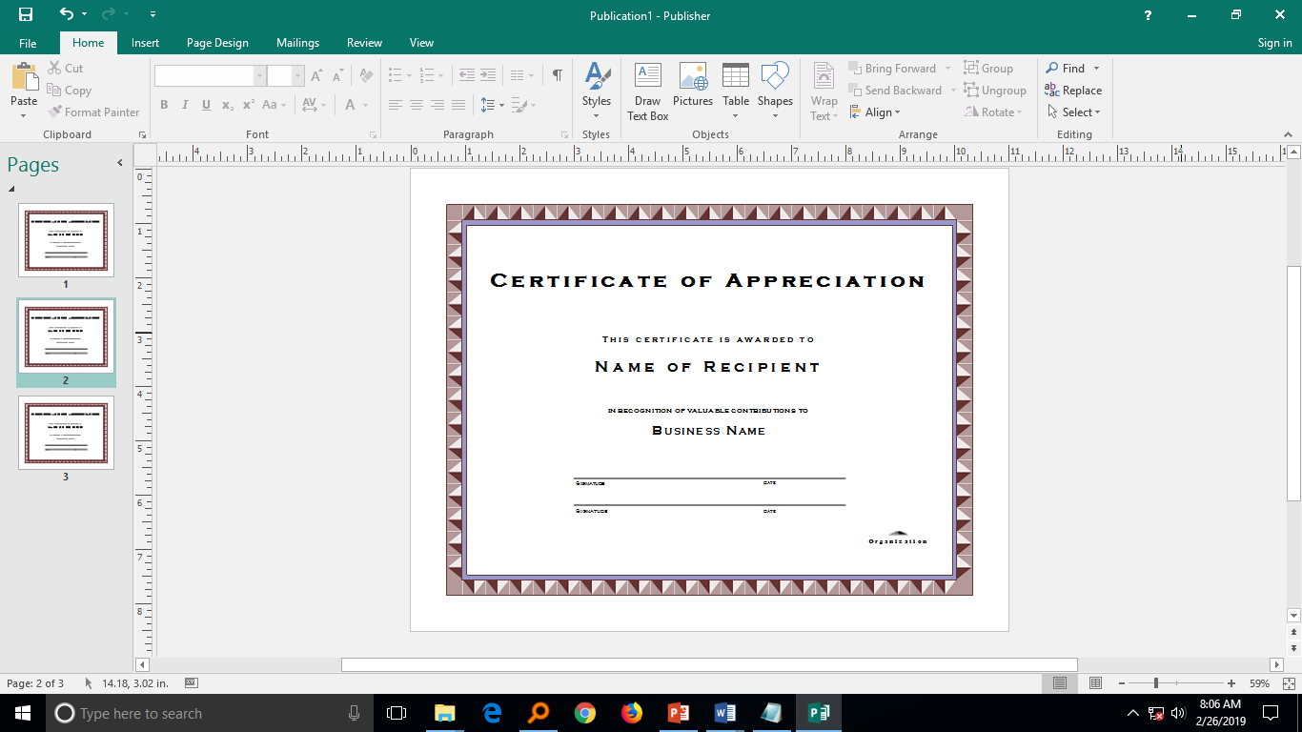
12.2.1 Creating a new document
The Publisher 2016 Window
Publisher 2016 appears as displayed below when a new file is created basing on one of the publication templates that can be chosen from its start screen.

Slide 15
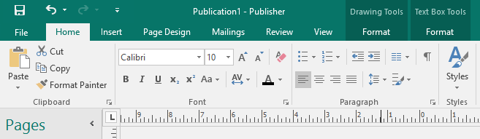
12.2.1 Creating a new document
The Publisher Window – Key Tabs and Elements
Home Tab: contains buttons for common functions (e.g., basic formatting, insertion, common commands , text formatting (e.g., font, text alignment, or line spacing) etc.)

Slide 16
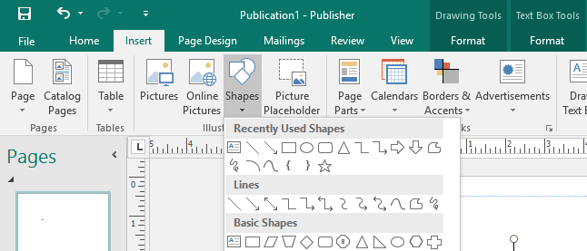
12.2.1 Creating a new document
The Publisher Window – Key Tabs and Elements
The Insert Tab: This ribbon allows you to insert text boxes, tables, and shapes and graphics to your publication.

Slide 17
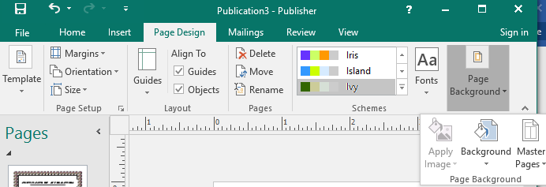
12.2.1 Creating a new document
The Publisher Window – Key Tabs and Elements
The Page Design Tab: The page design tab is a very important consideration within publications, with a range of options, from the page size to page design schemes and master pages.

Slide 18
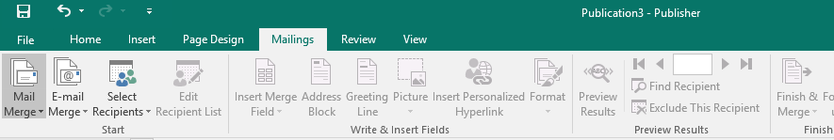
12.2.1 Creating a new document
The Publisher Window – Key Tabs and Elements
The Mailings Tab allows for the creation of mail merge documents from a data source such as form letters, labels, cards etc. much as you can in Microsoft word but in publisher you have a more flexible ability when dealing with objects on the publication and in the design of the Page. The tab however is very similar to the mailings tab in word and the method is very much the same.

Slide 19
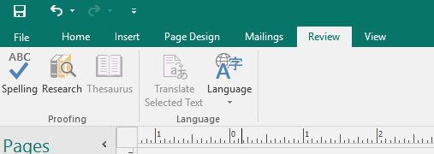
12.2.1 Creating a new document
The Publisher Window – Key Tabs and Elements
The Review Tab The review tab has much less functionality within Publisher it merely gives you the standard proofing and language options that you need to work with for dealing with text, that you would find in any of the other applications.

Slide 20
12.2.1 Creating a new document
The Publisher Window – Key Tabs and Elements
The Review Tab The review tab has much less functionality within Publisher it merely gives you the standard proofing and language options that you need to work with for dealing with text, that you would find in any of the other applications.

Slide 21
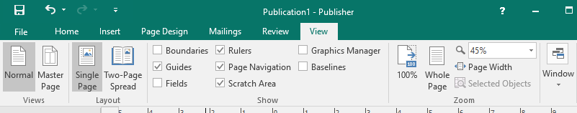
12.2.1 Creating a new document
The Publisher Window – Key Tabs and Elements
The view tab allows you to turn on and off the various aspects of publisher that you would wish to see (or not see) such as the guides. It will allow you to change from single page to two page spreads etc. you may adjust the zoom and set window characteristics when dealing with multiple publications.

Slide 22
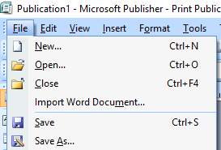
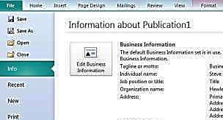
12.2.1 Creating a new document
The Publisher Window – Key Tabs and Elements
The File tab (Backstage) lets you create, save, open and close files, modify the Publisher program options, and close Publisher. If you have used Publisher in the past, the File Tab (Backstage) is very similar in functionality to the File menu (Publisher 2007) and previous versions.

Slide 23
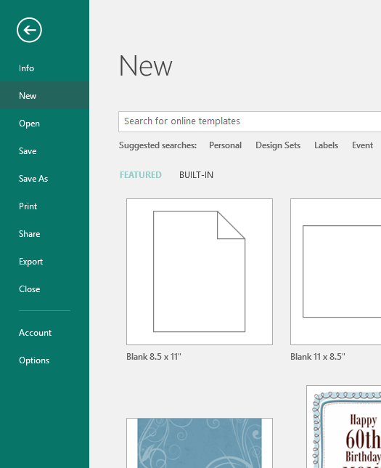
12.2.1 Creating a new document
Let’s take a look at some of the commands in the File Tab /Backstage.
New: Used to Create a New Publication. Also displays a list of present blank publication sizes and a number of templates from which you can choose one as a starting point for your desired publication.

Slide 24
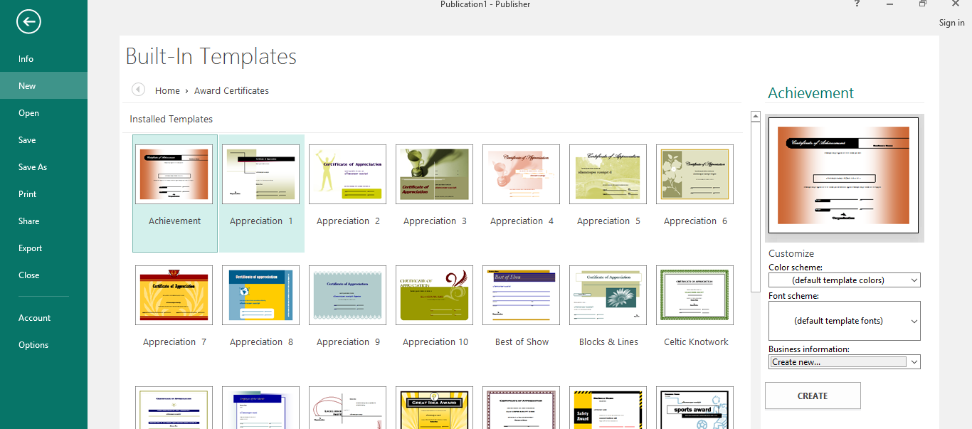
12.2.1 Creating a new document
For example, to quickly create a certificate, you can click on the ‘Award Certificates’ category, choose any of the templates and click on the CREATE button as shown below.

Slide 25
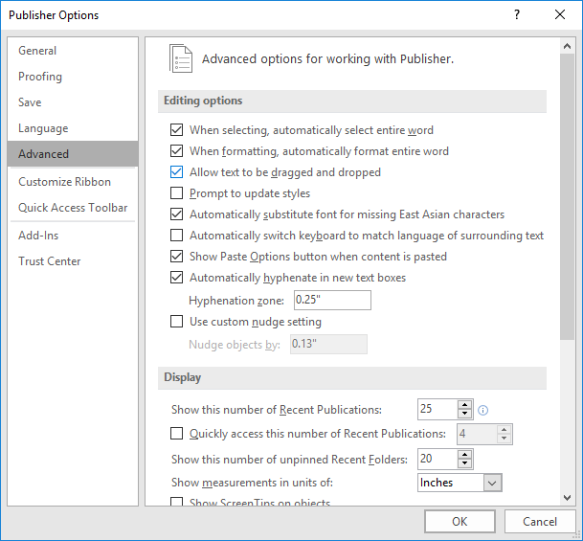
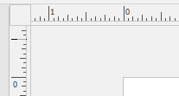
12.2.2 Adjusting measurement units (inches, pixels, points, and centimetres)
Rulers help you measure the length of your text boxes, images, and other objects relative to how they will appear in print. You can change the unit of measure from the Options dialog box under the File tab->Options->Advanced (Originally under Tools Menu->Options-General in Publisher 2007).

Slide 26
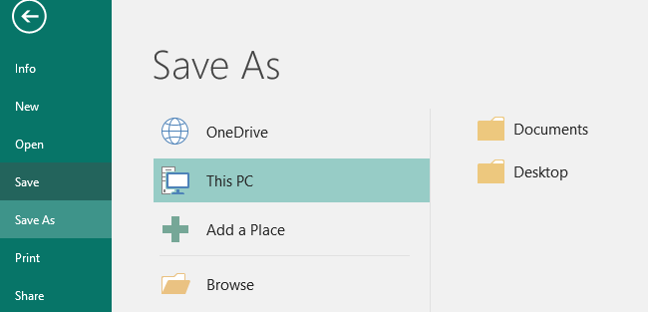
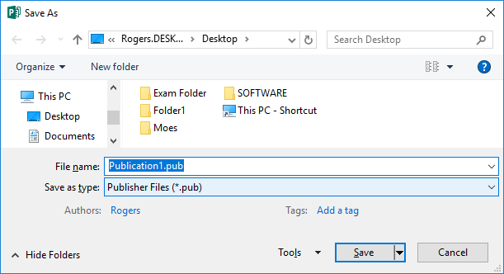
12.2.3 Saving a new document
Save. This command adds any modifications you have made to the current Publication file. It is always advisable to first save your file to disk before continuing to do work on it. When you Click on File->Save (Or Ctrl+S) for the first time, you will be required to select a location where to save your work, such as on the Desktop or any other location under ‘This PC’, after which the Save As dialog box will appear for you to specify the file name and any other options before clicking on the SAVE button. The file extension of a publisher file is .pub.

Slide 27
12.2.4 Typesetting text
Unlike in word-processing, in publisher one important thing to remember is that all text needs to be laid out in a text box.
A text box is an area that contains text only and can be moved to any part of the publication. Type within a text box can only fill the area of the text box, not the entire publication. Before typing text, a text box has to be created as follows.
From the INSERT tab, Text group, click DRAW TEXT BOX .
Move the mouse pointer to where the text box should begin. The mouse pointer will appear in a cross shape.
To create the text box, click and drag

Slide 28
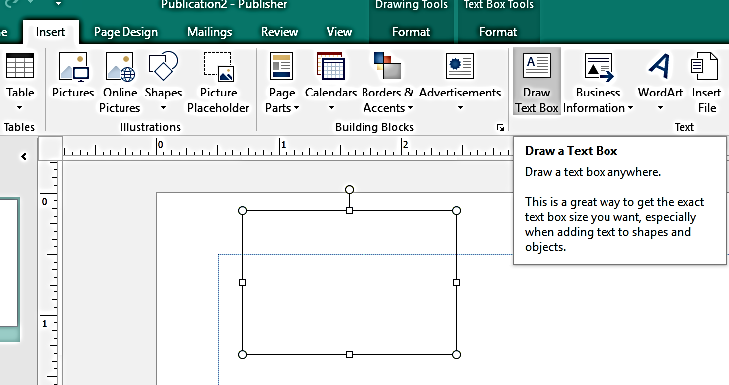
12.2.4 Typesetting text
iv. Release the mouse button when the text box is the desired size.

Slide 29
12.2.4 Typesetting text
To type text, click inside the textbox and start keying in characters, for example type text “Banana Republic”: To see the text better, zoom in by pressing [F9]. To zoom out, press [F9] again.
Importing text from another document such as a support file:
Usually, if you are using a text box for a large amount of text (such as the body text of an essay or article) you will be copying it from a word processing program. Typing large volumes of text inside Publisher is not advised.
i. Open and select the text to be copied from the origin document
ii.Copy the selected text (Ctrl+C)

Slide 30
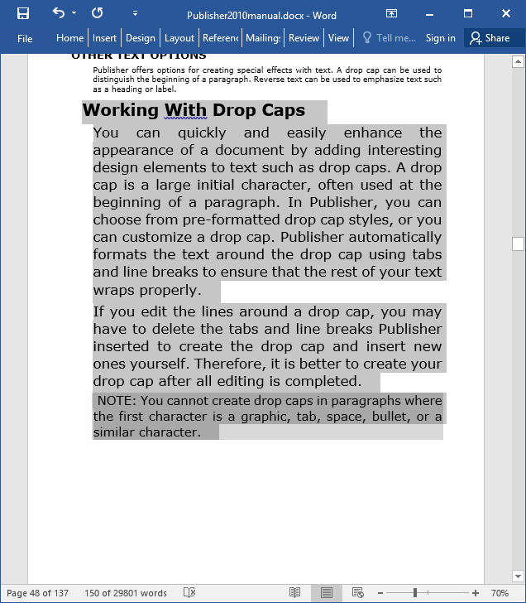
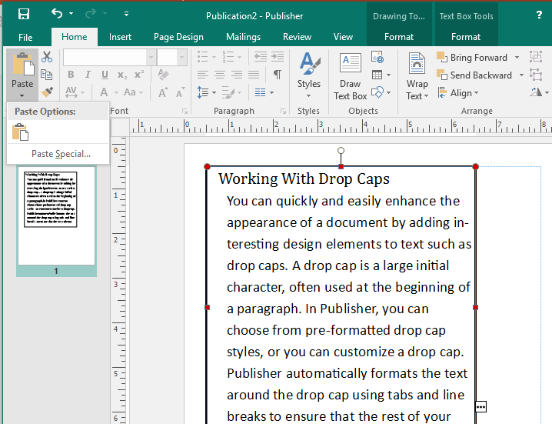
12.2.4 Typesetting text
iii. In Publisher, Click inside your textbox and use the PASTE command (Ctrl+V) under the HOME tab, or click on the down arrow under paste and select PASTE SPECIAL for more paste options e.g unformatted text which may be more desirable. You may have to resize the textbox to fit.

Slide 31
Sub Topic 12.3: Document Enhancement
Sub topic Objectives:
12.3.1 Changing Background Colour.
12.3.2 Text Box properties and formatting.
12.3.3 Inserting Graphics.
12.3.4 Inserting Page Borders.
12.3.5 Formatting Text.
12.3.6 Importing Text.
12.3.7 Adding Page Numbers.
12.3.8 Checking Spelling.
12.3.9 Changing Spacing.
Notes:
Having finished inserting text boxes, we choose to insert shapes instead.

Slide 32
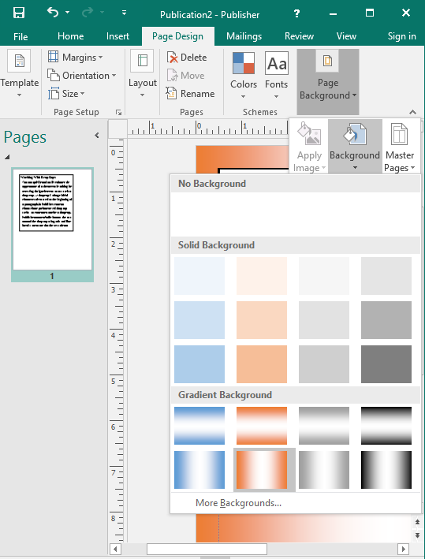
12.3.1 Changing Background Colour.
Publisher has a lot of options for page background and general appearance enhancement under the PAGE DESIGN Tab.
Go to Page Design Tab -> Page Background group -> Background and chose one of the present backgrounds or click on “More Backgrounds..” to open the Format Background dialog for more custom background options.

Slide 33
12.3.1 Changing Background Colour.
Publisher has a lot of options for page background and general appearance enhancement under the PAGE DESIGN Tab.
Go to Page Design Tab -> Page Background group -> Background and chose one of the present backgrounds or click on “More Backgrounds..” to open the Format Background dialog for more custom background options.

Slide 34
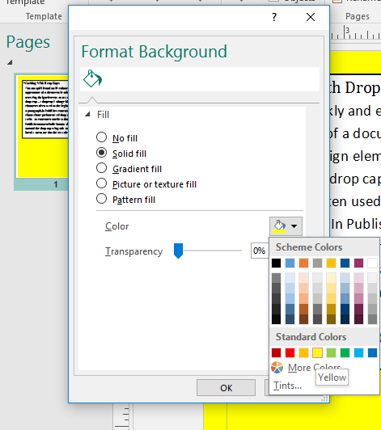
12.3.1 Changing Background Colour.
The Format Background dialog box also has options for
gradient fill (where you can mixup and vary many shades of color,
Picture or texture background and
patter fill and
transparency settings.
NB: Feel free to practice with the various options, but always use backgrounds which sharply contrast with foreground content like text so that it remains easy to read.

Slide 35
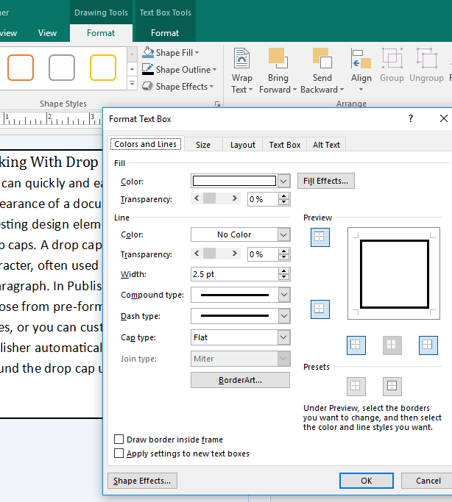
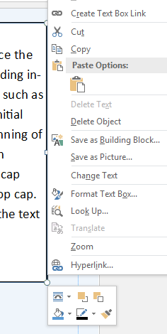
12.3.2 Text box properties and formatting.
Text boxes have a number of properties and formatting options which enhance a document’s look. They are on the Format Text Box Dialog box which can be opened by Right clicking on the textbox border and choosing “Format Textbox” from the popup menu.

Slide 36
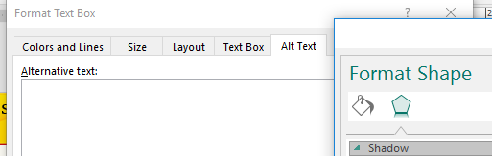

12.3.2 Text box properties and formatting.
The Format Text Box Dialog box has options in 5 Tabs:
The Colors and Lines tab where you can change the fill color, line color and border art;
The Size tab where you can set an exact width, height, rotation and scaling of the text box.
The Layout tab where you can set the text box’s position on page and wrapping style.
The Text Box Tab where you can set the vertical alignment, textbox margins, number of columns within the textbox and the text auto fitting options.
The Alt Text tab is used for entering information about the textbox useful for people with vision impairments.
You can also click on the Shape Effects button at the bottom to apply effects like the shadow, reflection, etc to the textbox.

Slide 37
12.3.3 Inserting Graphics
Graphics can add interest and variety to your publication. Graphics can be cropped, sized, and moved in Publisher. Some graphics, depending on their format, can be recolored in Publisher.
During the practical exams, some graphics are usually included in the support files folder.
Graphics come in a variety of file formats.
If you are having your publication commercially printed, check with your printer as to the file format that they prefer. If you are getting unsatisfactory results with your graphic, try using a different file format. Graphic formats supported by Publisher without the use of a graphics filter include:
Windows Bitmap (.BMP)
Tagged Image File Format (TIFF or .TIF)
Graphics Interchange Format (.GIF)
Joint Photographics Expert Group (JPEG or .JPG)
Portable Network Graphics (.PNG)
Windows Enhanced Metafile (.EMF)
Windows Metafile (.WMF)

Slide 38
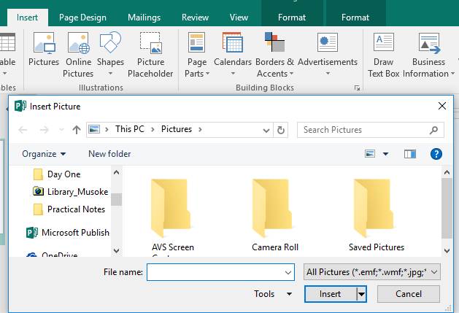
12.3.3 Inserting Graphics
To insert a graphic:
From the INSERT Tab, ILLUSTRATIONS group, select Pictures. The INSERT PICTURE dialog box appears.
Locate and select the image file you want to insert
Click INSERT. The graphic appears on your publication.

Slide 39
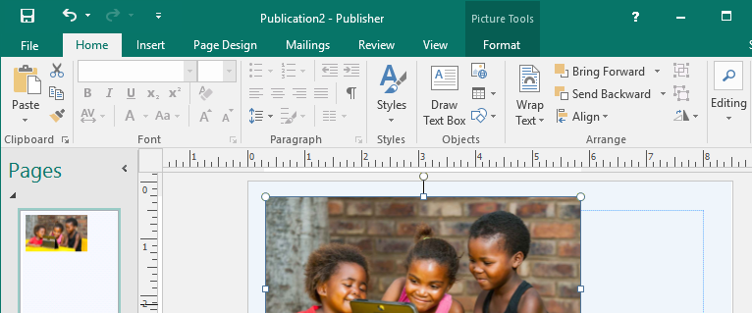
12.3.3 Inserting Graphics
Resizing A Graphic
With Publisher's ability to resize and crop graphics, you can make adjustments so that the graphic better meets your needs.
Select the graphic to be resized. Sizing handles appear on your graphic. To change your image proportionately, click and drag one of the corner sizing handles until the graphic reaches the desired size.

Slide 40
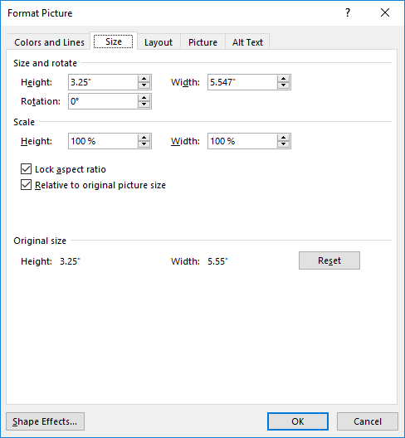
12.3.3 Inserting Graphics
Alternatively, The Format Picture dialog box can be used to change the size and other properties of the graphic.
Right Click on the Graphic and Choose Format Picture…. The FORMAT PICTURE dialog box appears.
To resize, click on the SIZE tab. Enter HEIGHT and WIDTH in the SIZE AND ROTATE area of the dialog.
You may enter a percentage of the original size in the SCALE area of the dialog.
NB: To keep the picture proportional keep the lock aspect ratio checkbox ticked otherwise the picture will be distorted
Click OK to close the dialog and apply the changes to the graphic.
NB: Check out other options in the rest of the Tabs in this Format Picture dialog box.

Slide 41
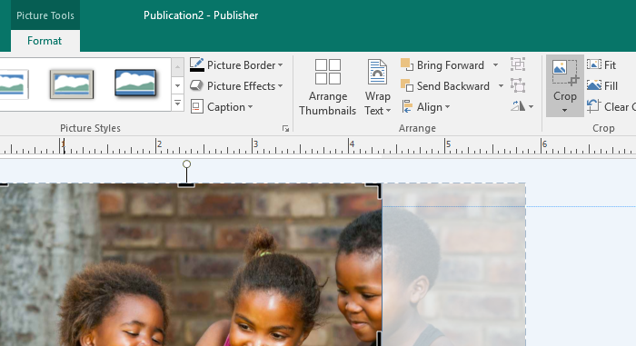
12.3.3 Inserting Graphics
Cropping Graphics
Publisher's crop feature hides portions of a graphic, rather than simply eliminating them. Therefore, cropping does not actually reduce the graphic size. If necessary, you can reveal previously cropped portions of an image by dragging the borders.
To crop a graphic:
Select the graphic to be cropped.
From the PICTURE TOOLS tab, click CROP in the CROP group. The normal resizing handles will change to black border handles.
NOTE: If this button is grey (unavailable), the image cannot be cropped in Publisher. You will need to use a graphics program like Paint.
Click and drag the black Handles at the borders until the picture is the desired size
Release the mouse button. The graphic is cropped.
Click on the CROP button again to return the handles to their standard appearance.

Slide 42
12.3.4 Inserting Page Borders.
In publisher, you can use the MASTER PAGE to insert page boarders and other elements which are usually shared across many pages in the publication.
Master pages save you time because they allow you to type or draw information once on the master pages so that this information appears on all the pages of your document.
Some elements that might be useful to place on your master pages include the following:
Page Borders
Page numbers, headers, and footers
Any graphic that you want to appear at the same location on every page
A layout grid (with non-printing ruler guides) and column guides, etc.

Slide 43
12.3.4 Inserting Page Borders.
In publisher, you can use the MASTER PAGE to insert page boarders and other elements which are usually shared across many pages in the publication.
Master pages save you time because they allow you to type or draw information once on the master pages so that this information appears on all the pages of your document.
Some elements that might be useful to place on your master pages include the following:
Page Borders
Page numbers, headers, and footers
Any graphic that you want to appear at the same location on every page
A layout grid (with non-printing ruler guides) and column guides, etc.

Slide 44
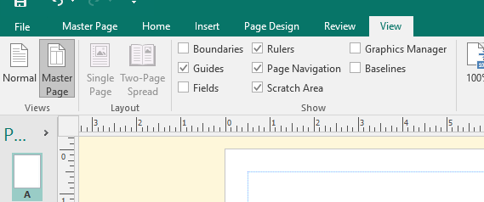
12.3.4 Inserting Page Borders.
To go to the master page, From the VIEW TAB/ MENU, select MASTER PAGE or press CTRL+M
By default, Master A, which is applied to all pages in your publication, will be opened ready for editing.

Slide 45
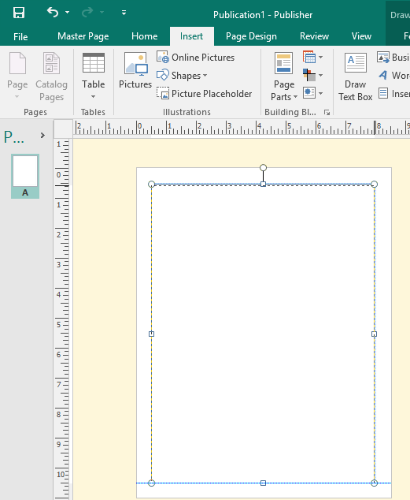
12.3.4 Inserting Page Borders.
To insert a Page border on a Master Page, draw a text box or rectangular auto shape which will act as the page border, across the page, preferably over the margin guide lines which are usually visible on the master page.
The next step is to format the textbox to appear as our desired page boarder:

Slide 46
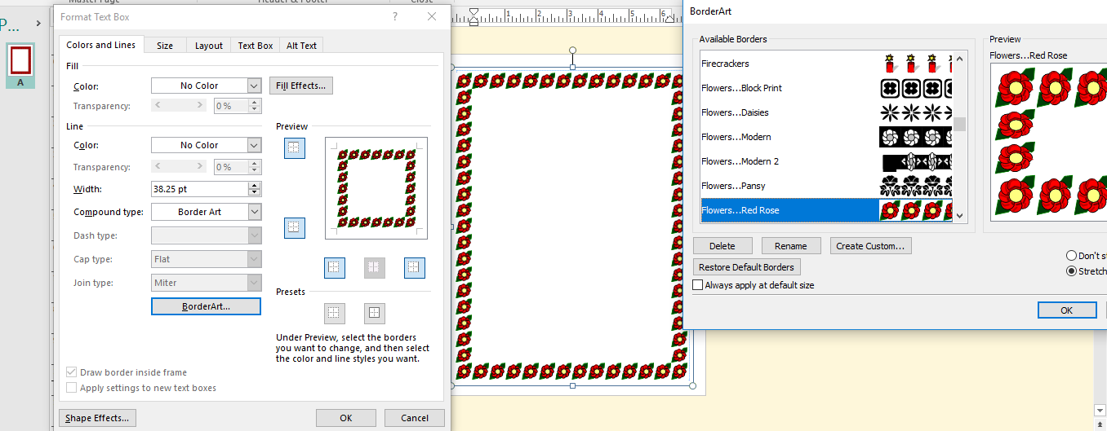
12.3.4 Inserting Page Borders.
Right Click on the text box or auto shape and select Format Textbox… and then use the Format Dialog Box to choose a border style. Several options exist such as compound lines, colored lines or boarder art.
After applying your border, you can now close the master page by pressing Ctrl+M or the clicking on the red close button on the ribbon.

Slide 47
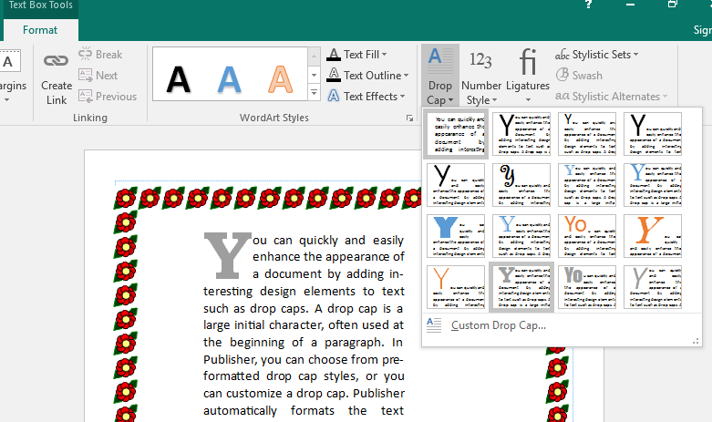
12.3.5 Formatting Text.
Polisher supports most of the text formatting features which we covered in word processing such as font size, color, bold, italic, etc.
Publisher also offers options for creating special effects with text. A drop cap can be used to distinguish the beginning of a paragraph. Reverse text can be used to emphasize text such as a heading or label.

Slide 48
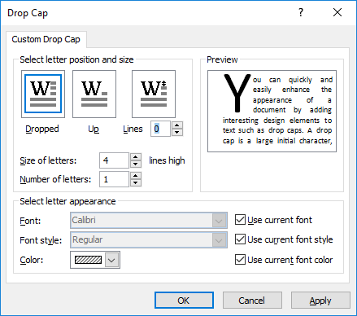
12.3.5 Formatting Text.
Publisher’s Drop Cap formatting
Place your insertion point in the paragraph in which you would like to add the drop cap
From the FORMAT tab under the contextual Text box tools, select DROP CAP... The DROP CAP menu appears.
Make a selection to apply the drop cap to your paragraph, or click on Custom Drop Cap for more control in the Drop Cap Dialog Box.

Slide 49
12.3.5 Formatting Text.
Formatting Reverse Text
Instead of the usual black text on white background, you might want to emphasize a portion of your document by using reverse text (i.e., white text on black). The process of creating reverse text is a simple one, requiring two main steps: changing the text color to white and creating the black background.
To set text to white
Click within the text box you wish to reverse
Press [Ctrl] + [A] or use mouse to select the text.
On the HOME tab, FONT group click the arrow next to FONT COLOUR select white.
The text will seemingly disappear. (white on white)
To set background to Black
i. On the DRAWING TOOLS, FORMAT contextual tab, click the SHAPE FILL colour and select BLACK
Click OK The text box is coloured black and now contains reverse text.

Slide 50
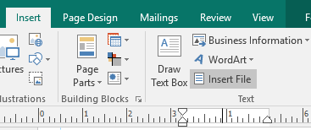
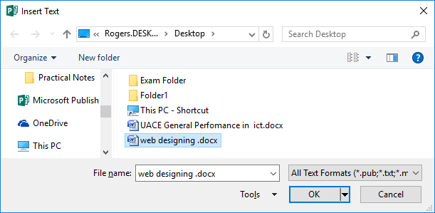
12.3.6 Importing Text
Instead of using Copy and Paste method of importing text into publisher, You can use the Insert File command under the Insert Tab, Text group to import the entire text in an exisiting file such as a word document.
You browse for the file with the text you wish to import using the Insert Text dialog box. Publisher creates a page for each of the pages in the file being imported, and also creates linked text boxes with the text for each page.

Slide 51
12.3.6 Importing Text
Text Autoflow
When you import or paste text, Publisher will create the text boxes necessary to accommodate it.
If the text file is larger than the text box, the information will be spread across pages (new pages will be added automatically) using AUTOFLOW creating multiple linked text boxes to allow all the text to be shown.
Linked text boxes allow text in the same story to be continued in multiple text boxes located on different pages

Slide 52
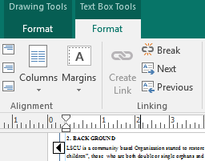
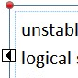
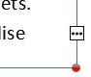
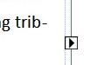
12.3.6 Importing Text
Working with linked text boxes
When text boxes are linked, Publisher gives you visual clues as to whether there is text previous to or following the current text box, and whether there is text in your story that is not yet displayed in your publication.
You will be using the linking group on the text box contextual tab as you work with linked text boxes. This group allows the linking and unlinking of text boxes and the ability to move from one linked text box to another forward or backward.
Text in Overflow: additional text not displayed in a text box
Go to Next Frame: additional text in the next text box
Go to Previous Frame: additional text in a previous text box

Slide 53
12.3.7 Adding Page Numbers
One useful elements that can be included on the master page(s) is automatic page numbering. Using automatic page numbering on the master page provides consistent placement and formatting of page numbers.
To add page numbers in master pages
From the VIEW tab, select MASTER PAGE View
If you have multiple master pages, select which master you wish to add page numbering to, from the navigation pane.
Click the Show Header / Footer button on the master page tab.
Automatically, the header and footer text boxes will appear on your master page.
The Insert Page Number, Date and Time buttons should now be available.

Slide 54
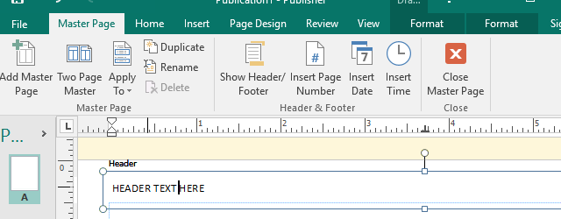
12.3.7 Adding Page Numbers
Position your cursor at the position in the footer or header you wish to insert the page numbering.
Click on the insert page number button from the ribbon to insert the page number.
You may insert date and time fields at any point in the header or footer in the same manner.
You may enter any other text in the header or footer to appear on any page
Close master page view to and apply the master to see the page numbering appear on your publication.

Slide 55
12.3.8 Checking Spelling.
Spell Check is a feature that checks for spelling errors in a document. Spell Check can be useful in preventing embarrassing mistakes, but be aware that Spell Check is not always right.
Spelling can be checked simultaneously with grammar.
By default, Spell Check is automatically on whenever an Office program is open. When you turn this feature off, Spell Check will not run as you work on your document. The feature can be easily activated using the Review command tab. You can also check the spelling in a document after you are finished typing.
To activate, from the REVIEW tab, in the PROOFING group, click SPELLING or Press [F7]

Slide 56
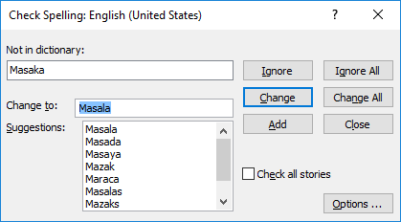
12.3.8 Checking Spelling.
The CHECK SPELLING dialog box appears.
Make the desired selection for each misspelling, choices as per previous table.
When Spell Check is complete, in the dialog box that appears informing you of completion, click OK to close all dialogs.
NB: Modifying text in a dictionary can be useful so that Spell Check does not mark certain words and names as misspelled. In order to remove words from or add words to a dictionary, you go to the FILE tab, and click OPTIONS> CATEGORIES > PROOFING.

Slide 57
12.3.9 Changing Spacing.
Publisher automatically adds add spacing between lines and paragraphs, but allows it to change it as needed.
Like character and word spacing, the right amount of line spacing makes text easier to read.
The amount of space between lines of text is called leading, while the amount of space between paragraphs is called paragraph spacing.
You can also adjust spacing by changing the margins within a text box, which can create the appearance of white space between text boxes or objects that are immediately adjacent to one another.

Slide 58
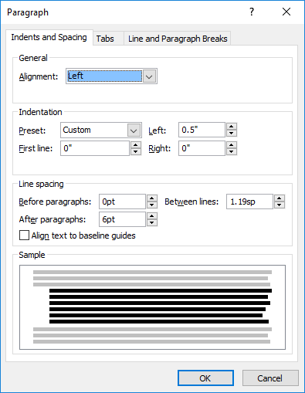
12.3.9 Changing Spacing.
To set line spacing
Place the insertion point in the paragraph you want to adjust
From the HOME tab, Click the dialog box launcher in the PARAGRAPH group The PARAGRAPH dialog box appears.

Slide 59
12.3.9 Changing Spacing.
Select the INDENTS AND SPACING tab
Under LINE SPACING, in the BETWEEN LINES text box, type the appropriate number or use the nudge buttons to select a value.
The units displayed in this list (sp) are spaces (e.g., double or single spaced).
Click OK.
The new line spacing is applied to the lines of the paragraph.

Slide 60
12.3.9 Changing Spacing.
Select the INDENTS AND SPACING tab
Under LINE SPACING, in the BETWEEN LINES text box, type the appropriate number or use the nudge buttons to select a value.
The units displayed in this list (sp) are spaces (e.g., double or single spaced).
Click OK.
The new line spacing is applied to the lines of the paragraph.
NOTE: These leading values apply to the entire paragraph. What constitutes reasonable leading space varies with the requirements of each document and each font used.

Slide 61
12.3.9 Changing Spacing.
Setting Paragraph Spacing
At times, you may want to emphasize a particular paragraph to draw the reader's attention. In many cases, adding space around the paragraph will be more effective than using fancy and distracting graphics or borders.
In addition, you may want to separate each paragraph rather than indent new paragraphs.
Publisher allows you to set the amount of space before and/or after each new paragraph.

Slide 62
12.3.9 Changing Spacing.
To set paragraph spacing
Select one or more paragraphs
From the HOME tab, Click the dialog box launcher in the PARAGRAPH group The PARAGRAPH dialog box appears.
Select the INDENTS AND SPACING tab
To set the amount of space inserted before each selected paragraph, under LINE SPACING, in the BEFORE PARAGRAPHS text box, type the appropriate number or use the nudge buttons to select the appropriate value.
To set the amount of space inserted after each selected paragraph, in the AFTER PARAGRAPHS text box, type the appropriate number or use the nudge buttons to select the appropriate value
Click OK. The new spacing is applied to the selected paragraph(s).

Slide 63
12.3.9 Changing Spacing.
Positioning Text Within The Text Box
Adjusting text box margins allows you to adjust the position of text within its text box.
Text box margins are the amount of internal space between the text and the edge of the containing text box.
Adjusting these margins may be appropriate only for display text, banner text, or text boxes that have visible borders.
You may also use alignments to position where your text will be aligned to in the text box.

Slide 64
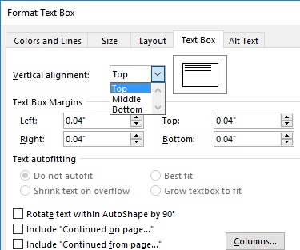
12.3.9 Changing Spacing.
To position text:
Select the desired text box
From the TEXT BOX TOOLS, FORMAT tab, Click the dialog box launcher in the TEXT group. The FORMAT TEXT BOX dialog box appears.
On the TEXT BOX tab, in the TEXT BOX MARGINS section, in the LEFT, RIGHT, TOP, and BOTTOM text boxes, type or use the nudge buttons to select the appropriate value .
To further position the text vertically, from the VERTICAL ALIGNMENT pull-down list, select TOP, MIDDLE, or BOTTOM
Click OK. The new alignments are applied to the selected text box.

Slide 65
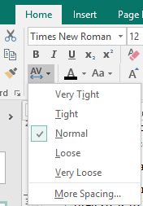
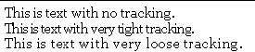
12.3.9 Changing Spacing.
Working With Character Spacing
Tracking and kerning are two Publisher options for controlling the space between characters.
Tracking adjusts the relative space between characters by a user specified percentage. Tracking is useful when you want to alter the spacing between characters on a large scale (e.g. sentence, paragraph, story, etc.).
Publisher offers several tracking options from Very Loose to Very Tight. You can adjust the track for a single line or an entire paragraph.

Slide 66
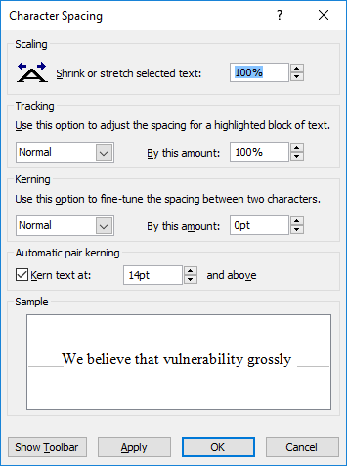
12.3.9 Changing Spacing.
To adjust tracking:
Select the text that you want to track
From the HOME tab, Click the CHARACTER SPACING button in the FONT group from the menu make a selection or select MORE SPACING, The CHARACTER SPACING dialog box appears.
In the TRACKING section, from the pull-down list, select either Normal, Very Tight, Tight, Loose, Very Loose, or Custom.
NOTE: Your selection is previewed in the Sample section.
If you select CUSTOM, in the BY THIS AMOUNT text box, type a percentage or use the nudge buttons .
Click OK

Slide 67
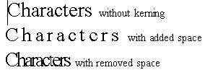
12.3.9 Changing Spacing.
Adjusting Kerning
If you have to alter the space between two specific characters, you will want to use kerning.
Kerning is a specific and focused type of character spacing that puts a user specified amount of space between the characters that are selected. Kerning is useful when working with especially large font sizes (e.g. a title or headline) or especially small ones (e.g. footnotes or picture captions), where the individual characters may be placed too close together or too far apart by the program.
Publisher allows you to kern text manually, automatically, or both.

Slide 68
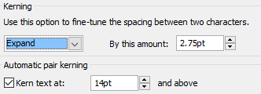
12.3.9 Changing Spacing.
To set kerning:
Select the characters you want to kern
From the HOME tab, Click the CHARACTER SPACING button in the FONT group from the menu select MORE SPACING, The CHARACTER SPACING dialog box appears.
In the AUTOMATIC PAIR KERNING section, select KERN TEXT AT
In the KERN TEXT AT text box, use the nudge buttons or type the font size at which automatic kerning will occur
OR To set Manual kerning, in KERNING section, from the pull-down list, select either Normal, Expand, or Condensed. In the BY THIS AMOUNT text box, type the appropriate number or use the nudge buttons.
NB: You many also simply use the Scaling option to stretch or shrink text horizontally.

Slide 69
Sub Topic 12.4: Document Layout
Sub topic Objectives:
12.4.1 Aligning a Document
12.4.2 Distributing Graphics in a Document
12.4.3 Organizing Text Along Objects
12.4.4 Customizing Page Size

Slide 70
12.4.1 Aligning a Document
If you would like objects in a document to line up in a special way, but are having trouble adjusting each object to the perfect alignment, you can force them to more easily align.
Publisher offers three options for forcing alignment. You can make objects align relative to margins, to guides, and/or to other objects.
This feature makes consistent alignment of multiple objects easy by causing objects to more easily be placed along a guide, ruler, or other object while you are moving it.
The align option is subtle and may be difficult to notice, but it makes lining objects up much easier.

Slide 71
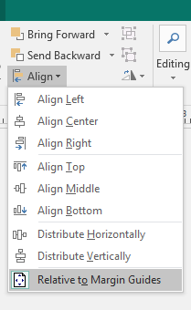
12.4.1 Aligning a Document
You can use one or any combination of the following options:
To Align to Margin Guides:
On the HOME tab in the ARRANGE group click on the arrow next to the ALIGN button from the menu that appears select RELATIVE TO MARGIN GUIDES.
This will now align / snap objects to the margin as you position them.

Slide 72
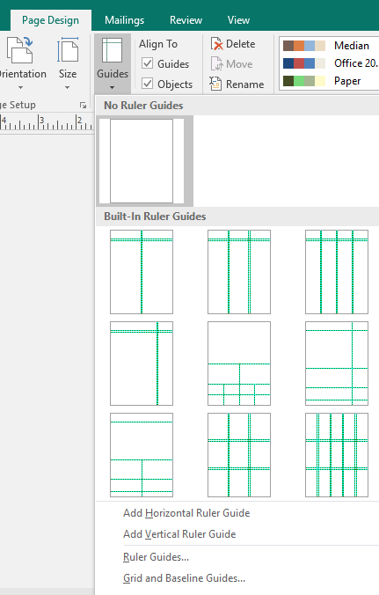
12.4.1 Aligning a Document
To Align to Guides:
Align to Guides will align objects to a guide.
New ruler guides can be placed as you need them for alignment.
On the PAGE DESIGN tab in the LAYOUT group click on the arrow at the bottom of the GUIDES button a menu appears.
You can use preset guides or Select RULER GUIDES to set guides at specific positions on your page.

Slide 73


12.4.1 Aligning a Document
In the Ruler Guides dialog box, Enter specific measurements at the flashing cursor and click SET. The ruler guide is set
Enter vertical or horizontal guides as you wish. Click OK to close the dialog and return to your publication.
To reposition the guide, place your pointer over the guide you want to move. The mouse becomes a double-sided arrow -drag the guide to its new location. To remove the guide, drag the guide into the ruler area.

Slide 74


12.4.1 Aligning a Document
After placing your guides, you can now activate aligning objects to a guides From the PAGE DESIGN tab, by selecting / checking the ALIGN TO, GUIDES check box.
To Hide All Guides or boundaries, from the VIEW tab, uncheck GUIDES.(or boundaries).

Slide 75


12.4.1 Aligning a Document
Align to Objects
Align to Objects will pull an object toward the object nearest to it.
i. From the PAGE DESIGN tab, select the ALIGN TO, OBJECTS check box. The option is selected if a check mark appears.

Slide 76

12.4.2 Distributing Graphics in a Document
If you want to change the placement of graphics in a document, you can move the it to a new location. There are two ways to move an object: the mouse or the keyboard.
USING THE MOUSE:
Select the object(s) to be moved. To select more than one item, hold down the [SHIFT] key + select the items.
Position the pointer over the object. The pointer turns into a four-headed arrow.
Click and drag the object to a new location
Release the mouse button. The object is moved.
KEYBOARD
Select the object(s) to be moved.
To move the selected objects 5 pixels at a time, hold down [SHIFT] key + press the [ARROW] key in the direction you want the object to move To move the selected objects 1 pixel at a time, press the arrow key in the direction you want the object to move
Release the keys. The object is moved.

Slide 77



12.4.3 Organizing Text Along Objects
Wrapping Text Around Objects
If an object/ graphic is to be placed on the same page as text, you may want the text to wrap around it in some way. Text can be wrapped around either a graphic placed into Publisher or an object created with Publisher drawing tools.
To Wrap Text around an object:
Select the desired graphic or object
From the HOME tab, arrange group click WRAP TEXT. A menu appears.
Select the appropriate wrapping option. The text wraps in the selected manner.

Slide 78

12.4.4 Customizing Page Size
A very important aspect to working with publisher is to work with different page sizes even though you may only be printing on A4 paper.
Consider a leaflet that is A5 in size you may design it on screen using A5 size and then when you print you can tell publisher it is printing on A4. If the settings are correct then you can print two leaflets on the A4 paper while only working with the original single item onscreen.
Similarly if there are 10 business cards per A4 sheet you may design just the one on screen but print that one out 10 times on the A4 print sheet.
If this was Word you would create one card and replicate it 10 times on screen as you are working with the printed sheet in word and any change would have to be replicated 10 times.

Slide 79

12.4.4 Customizing Page Size
To work with another paper size:
From the PAGE DESIGN tab, in the PAGE SETUP group, click on the size button
Make a selection from the menu which page size you wish to use.
For more page sizes select the PAGE SETUP button from the menu
OR:
From the PAGE DESIGN tab, in the PAGE SETUP group, click on the dialog box launcher button to open the PAGE SETUP dialog:

Slide 80


12.4.4 Customizing Page Size
Select from the layout type what kind of publication you wish to create eg. Multiple pages per sheet, Booklet, One Page per sheet, etc each selection will offer different options.
One Page per sheet option
Multiple pages per sheet option
For multiple pages per sheet, there additional settings like the page size, target paper size, the horizontal and vertical gap, the side and top margins, etc. As you adjust these, a preview will show you how many pages (eg cards) will fit on each target sheet.

Slide 81
Sub Topic 12.5: Advanced Features
Sub topic Objectives:
12.5.1 Customising and Using Templates
12.5.2 Using Auto Shapes
12.5.3 Undertaking a complete publication projects (certificates, brochures, flyers, menus, newsletters and so on) and presenting the project to peers

Slide 82
12.5.1 Customising and Using Templates
A template is a document with pre-defined formatting and settings.
For example, if you were creating a newsletter, you could set the margins, columns, and guides where they need to be and save the file. You could then use that same file to create all your issues, building from the foundation you had saved; this way, every issue would be consistent.
If none of the existing Publisher templates fit your needs, you can create and or customize to your own template. The same template can be used over and over again without making changes to the original.

Slide 83

12.5.1 Customising and Using Templates
To create a file from template
Upon opening Publisher you should arrive at the AVAILABLE TEMPLATES window.
If you have just closed a publication and wish to create a new file from a template then From the FILE tab, select NEW... The AVAILABLE TEMPLATES screen appears.
NOTE: you may be shown different templates depending whether you are online or offline
Under MOST POPULAR or MORE TEMPLATES Publication Types, select a category of templates the gallery appears for the category you chose.

Slide 84

12.5.1 Customising and Using Templates
Using the drop-down menus on the CUSTOMISE pane, which appears on the right make the desired changes to your template.
The options you need to consider and customize
include:
Colour scheme
Font scheme
Business information
Whether to include business address,
Size, etc.
When you are done, click CREATE. Your new document opens in the publication window ready for editing.

Slide 85

12.5.2 Using Auto Shapes
Publisher provides the tools to create basic drawing elements (e.g., lines, ovals, rectangles, and custom shapes) by working with the tools in the Objects toolbar.
To Drawing Line and Shapes
From the INSERT tab in the ILLUSTRATIONS group, select from the drop down menu next to SHAPES a drawing object and when you move the mouse over the workspace, a crossbar (+) will appear as the cursor.
Position the centre of the crossbar (+) where the line or shape should start
Click and drag the mouse in any direction to create the object
Release the mouse button. The outline of the object appears.

Slide 86

12.5.2 Using Auto Shapes
Selecting Objects
An object must be selected in order to delete, move, or modify it. A selected object is surrounded by small open circles called handles. Objects are selected immediately after they are drawn and stay selected until you draw another object or until you click the mouse on the workspace. You can reselect an object by clicking on it.
To select multiple objects:
Click the first object. The object should now have handles. If it does not, try again.
Hold down the [SHIFT] key + click the other lines and shapes you want to select If you have accidentally selected the wrong object, hold down the [SHIFT] key + click the object to deselect it.

Slide 87

12.5.2 Using Auto Shapes
Selecting Line/Border Style
Publisher allows you to alter the style of lines, arrows, and borders; you can make them thin, medium, thick, dashed, or dotted.
NOTE: You may only have one line/border style applied at a time.
To set border style and weight.
Select the object you want to alter
From the DRAWING TOOLS, FORMAT tab, click SHAPE OUTLINE
From the menu move to the WEIGHT option choose a thickness for your outline iv. From the menu move to the DASHES option choose a style for your outline.
From the menu choose a COLOUR for your outline.
From the palette of choices that appears, select a style. The style is applied.

Slide 88

12.5.2 Using Auto Shapes
Rotating Objects
Rotating objects helps you customize your publication. With rotation, you can turn objects upside down, tilt them to the left or right, and flip them.
When an object is selected, one of the handles is filled with green. This green handle is used for rotation.
To rotate an object:
Select the object to be rotated
Position the pointer over the rotation handle. The pointer turns into a circular arrow.
Click and drag the rotation handle. To rotate an object in 15-degree increments, press [SHIFT] + drag the handle. To rotate an object on its base, press [CTRL] + drag the handle.
Release the mouse button and keys. The object is rotated.

Slide 89



12.5.2 Using Auto Shapes
Ordering layers of shapes
As you add more objects and text to your document, the order in which they appear on the page can affect how the page appears. For example, if a shaded box and a text box are in the same area, the text must be on top of the box in order for it to be readable.
To order graphics
Select the object to be layered
EXAMPLE: Select the triangle Notice it is in the middle of the three layers.
From the Arrange group, HOME tab select BRING FORWARD/BRING TO FRONT. The triangle is brought to the front of the three layers
From the Arrange group, HOME tab, select SEND BACKWARD/SEND TO BACK. The triangle is sent to the back of the three layers.

Slide 90
12.5.3 Undertaking a complete publication projects
This topic is best learnt through project based exercises. You should practice by doing lots of exercises.
For each of the items to be developed, should print out copies and make a presentation of your designed item for the rest of the class to comment and make improvements in the item.
Unless required in the task/qn, you are discouraged from using inbuilt templates while designing each of the items – original designs using your own graphics and shapes are encouraged.
Practice on how to adjust the units of measurement from inches, to pixels and to centimetres to develop this competence.
You can take on a project such as creating a newspaper for the schools current affairs club, making fliers, certificates, etc to allow you develop specific skills at a time.
Below are some exercises that can be done and presented in class.

Slide 91
12.5.3 Undertaking a complete publication projects
Exercise 1
Using a suitable publishing software, design eight identical business cards tiled on A4 page size, 3.5” wide and 2” height.
the cards’ layout and spacing is as follows;
left and right margin should be 0.5”.
top and bottom margins 0.7.
the vertical and horizontal gap between cards 0.6.
the details of the card are:
A logo of the company at the left hand side of the card. Provide the logo.
a company name of your choice.
Job title. E.g. Managing Director.
your name e.g. Aisha Kainembabazi.
contact address, phone and e-mail.
include crop marks around each card
Save the publication as “my business card’ and print your work.

Slide 92
12.5.3 Undertaking a complete publication projects
Exercise 2
Using a desktop publishing application of your choice, you are required to design a flier about the annual MTN marathon. This year’s marathon is dubbed, “Run for water”, and its proceeds will be used to install piped water in rural hospitals. The marathon will take place on 30th December. The following are the specifications of the flier:
Flier size 10cm x 28 cm, paper size A4.
Should print two fliers per paper, with a horizontal gap of 0.5cm.
A top margin of 0.9cm and a side margin of 0.25cm.
Add a simple and suitable design layout.
Design and Insert the MTN logo.
Use text boxes to add the details such as the Title, Theme, Entry fees, Date, Starting location, End location, Telephone Contact of organizer and email. T shirts will be provided to all participants. NB: Invent the above details where not provided.
Use at most three colors in your publication.
Add your name as header and print your work.
Save your work as Water Marathon.

Slide 93
12.5.3 Undertaking a complete publication projects
Exercise 3
Use any desktop publishing software to design a certificate of excellence for Kiryamenvu Senior Secondary Senior six (S.6) candidates who have excelled in the following application packages: Ms word, Ms Excel, Ms Powerpoint, Ms Access and Ms Publisher. Provide space for the signatures of the head teacher and the head of ICT department. (10 mks)
(a) Adjust the paper size to a width of 11 inches and a height of 8.5 inches. (02 mks)
(b) Insert a clip art to represent the owner’s photograph. (02 mks)
(c) Use your name as the owner of the certificate. (02 mks)
(d) Insert your name and personal number in the footer. (02 mks)
(e) Save and print your publication. (02 mks)

Slide 94

12.5.3 Undertaking a complete publication projects
Exercise 3
(a) Set up the card width at 3.4 inches and height at 2.2 inches.
(b) Set the Side and Top margins at 0.5 inches and all margin guides at 0.1 inches.
(c) Choose a layout type of Multiple pages per sheet and add a horizontal gap of 0.5 and a vertical gap of 1.1 inches.
(d) Use a table, autoshapes, text boxes, and clip art to create the above card design use at least three colors in your design.
You are the graphics designer of Computer Solutions LTD and you have been requested to design staff identity cards in the following format:

Slide 95
12.5.3 Undertaking a complete publication projects
Exercise 3 (continued)
Name | Designation | ID №:
NAKINGA JESSE | DIRECTOR | CSU/001
ABDUL MAJID NUR | GENERAL MANAGER | CSU/002
KISAAWE AHMED | SYSTEMS ADMINISTRATOR | CSU/003
<<YOUR NAME>> | GRAPHICS DESIGNER | CSU/004
MWESIGWA SAMUEL | TECHNICIAN | CSU/005
APIO JOAN | SECRETARY | CSU/006
(f) Printout all the 6 cards on one A4 size sheet of paper page.
(g) Save your work as CSU IDs.

Slide 96
12.5.3 Undertaking a complete publication projects
NB: For more practice, some practical exercises are included in the Subsidiary ICT for Uganda book at the end of each practical chapter, but for more on the support files approach, practical questions, lab activities, and over twenty sets of standard full past papers and their support files, get a copy of the book entitled “FOR COMPUTER PRACTICAL APPLICATIONS LAB ACTIVITIES for Uganda” - Second Edition 2018 by Mukalele Rogers.

Slide 97
Subsidiary ICT for Uganda
End of Topic 12:
Electronic Publication
Next Topic 13: Electronic Spreadsheets II

